Slide 1

SALES DATA ANALYSIS DASHBOARD

Slide 2
Objective
The primary objective of this project is to analyze retail sales data to gain actionable insights that will enhance performance and enable us to closely monitor our sales and overall performance.
Sales Dashboard – On next slide
For interactive dashboard please download excel file.

Slide 3
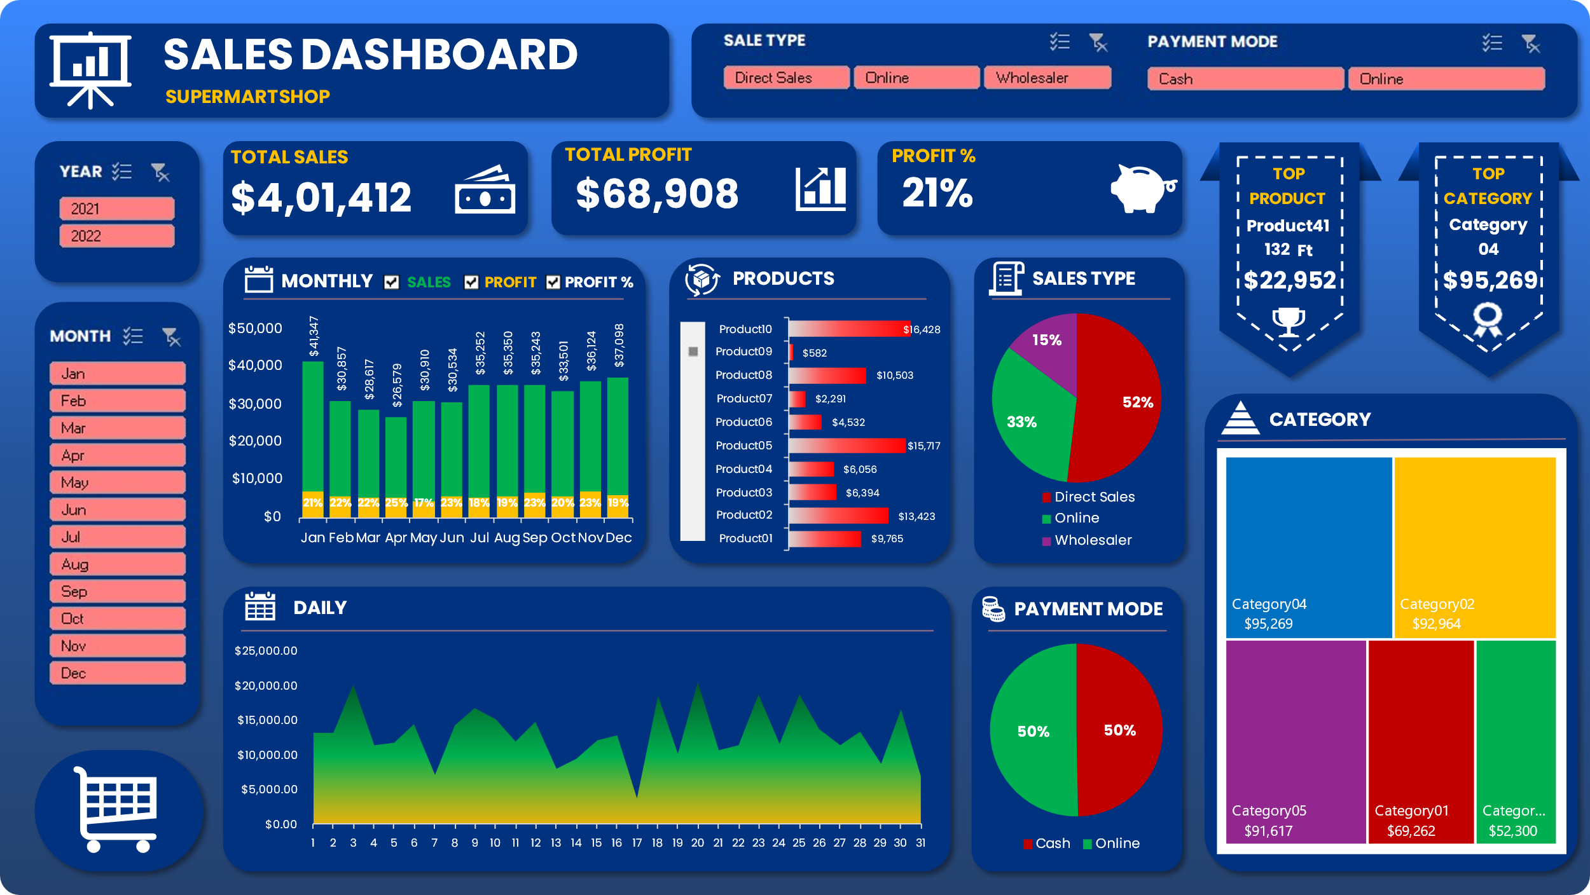

Slide 4
Insights:
Our highest sales were in January.
Our all-time top-selling product is Product41, with total sales of $22,952.
Our all-time highest-selling category is Category4, with total sales of $95,269.
52% of our sales come from direct sales, 33% through online channels, and 15% from wholesalers.
Our total profit is $69,908, with a total EBITA of 21%.
We receive 50% of payments online and 50% through cash transactions.

Slide 5
THANKS

